Slide 1
YACC - AUTOMATIC PARSER GENERATOR

Slide 2
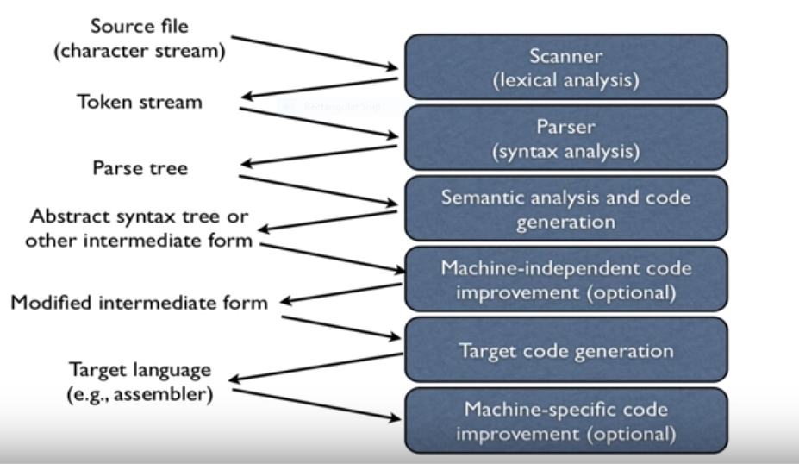
Language Processing

Slide 3
Cont…
While the generation of machine code parse tree plays a major role.
If the parse tree is efficient then we can generate machine code without any conflicts and very effectively.
YACC is one of the parser generator method.

Slide 4
Different Parsers
LL(1)
LR(0)
SLR(1)
CLR(1)
LALR(1)

Slide 5
What Is YACC ???
YACC stands for “Yet Another Compiler Compiler”.
YACC was created by S.C.Johnson in early 1970’s.
YACC is a Look Ahead Left-to-Right (LALR) parser generator, generating a parser.
YACC is generally available as a command on the UNIX system.

Slide 6
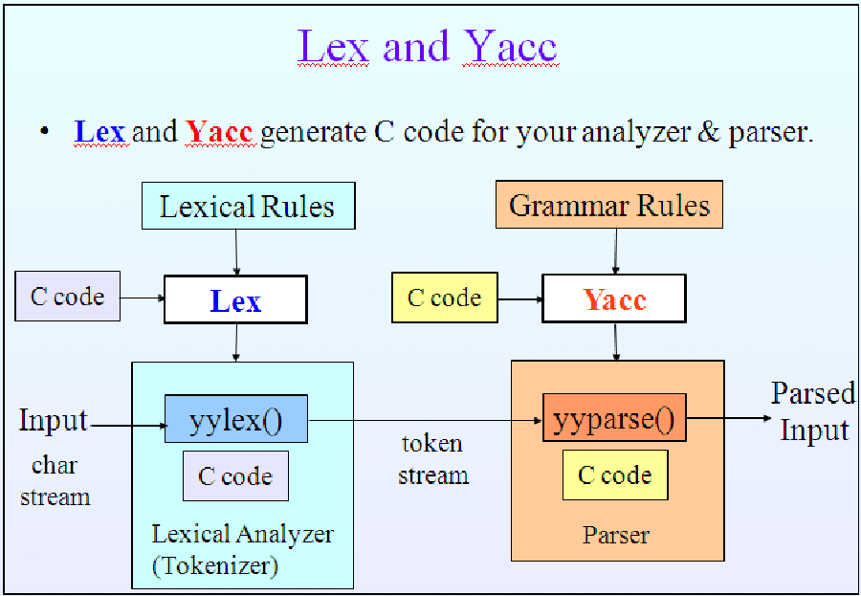

Slide 7
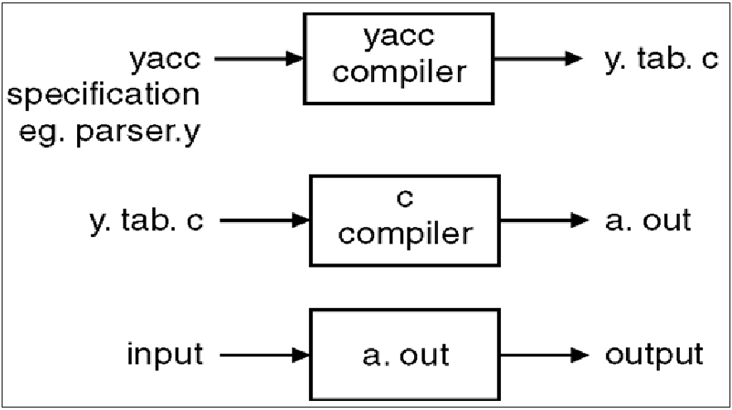
The Parser Generator Yacc

Slide 8
Syntax of Yacc
Declaration
%%
Translation rules
%%
Supporting C routines

Slide 9
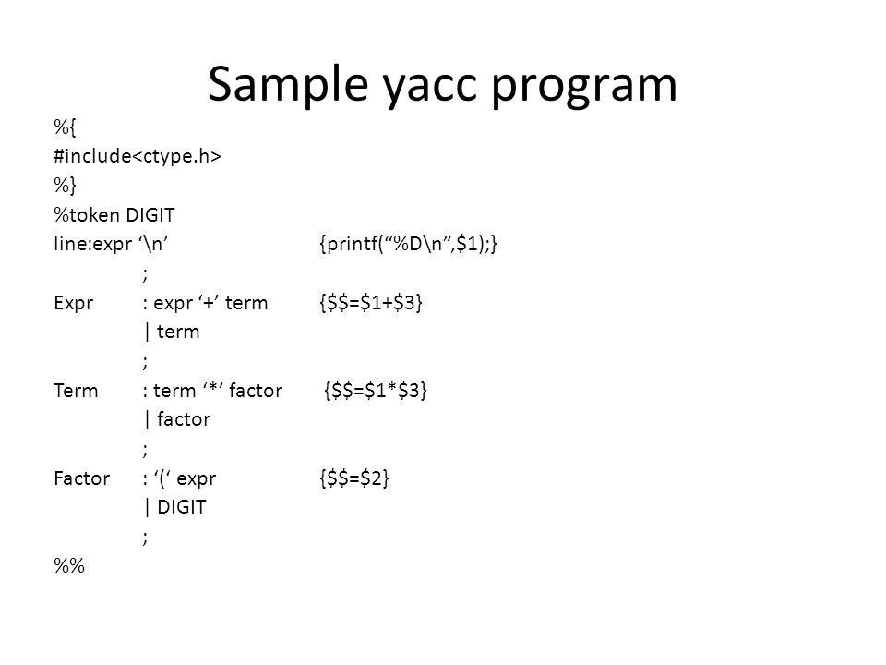

Slide 10
Creating Yacc Lexical analyzer with LEX
Lex library ll will provide driveer program named yylex().
#include “lex.yy.c” statement used to access the names of tokens.
In UNIX system
lex first.l
yacc second.y
cc y.tab.c –ly -ll

Slide 11
Error Recovery in Yacc
In Yacc error recovery In the form of Error Productions.
A->error α
where α starting grammar symbol
When an error occurred yacc pop the symbol from its stack until the top most symbol .
The Error production is of the form
A->.error α

